Slide 1
Central Minnesota Council Gateway District Roundtable March 2022

Slide 3
AGENDA
Pledge / Welcome
Safety Moment
Upcoming Dates
Meat Stick Sale
Crossover
District Committee
Breakouts

Slide 4
BSA SAFETY MOMENT
Campout Safety Checklist
https://www.scouting.org/health-and-safety/safety-moments/campout-safety-checklist/

Slide 5
March Council Updates 2022
Klondike Derby- March 4-5 - CANCELLED
March Merit Badge Blast@Parker – March 11-13
District Pinewood Derby – March 19 - Princeton
Yowl/Prowl/Howl/Growl + Bear Hibe/Webelos @Foley HS – March 26
Bunny Hop – April 9
CPR/Wilderness First Aid – April 21-23
Ripley Rendezvous – April 29-May1
Ad Altare Dei – May 14, June 11, Aug 27
Baloo/IOLS – May 20-21
Voyageurs – June 16-19
NOAC – July 25-30
Cub Camp

Slide 6
Doctor Neutron
And
Professor Proton!

Slide 7
More Dates
Gateway District Dinner – Potluck April 7
Princeton Leadership Breakfast – April 21, PGC 7am
Council Recognition Dinner – April 24, Council Office
Elk River Leadership Breakfast – April 28, Legion 7am
Elk River Day Camp – June 9-10
Council Canoe Trip – Tentatively July 9-12
NYLT – June 24-26, July 7-9

Slide 8
Meat Sticks Spring Sale 2022
Key Dates and Information
$1.00 per stick, $20 per case – 25% commission to the Scouts
February 11, 2022 - Meat Stick Orders due to the Scout Office
March 1, 2022 - Meat Stick Orders Picked up by Units
April 25, 2022 - Unopened cases returned to Scout Office
April 29, 2022 - Payment due to Scout Office

Slide 9
Webelos Crossover

Slide 10
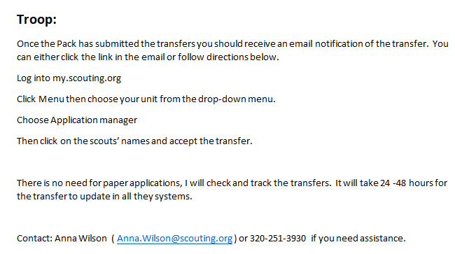
Webelos Crossover

Slide 11
District Committee

Slide 12
Discussion

Slide 13
Additional Tidbits of Information
Recruitment/Invitation Manager
Family FOS presentations

