Slide 1
Central Minnesota Council March 2021 Roundtable

Slide 2
Pledge of Allegiance

Slide 3
AGENDA – 7pm
AGENDA – 7:00pm
Welcome –
Attendance
Safety Moment – Guide to Safe Scouting
CMC Programs/Events/Training updates –
Big Rock –
Breakouts - 7:30pm

Slide 4
BSA SAFETY MOMENT – Guide to Safe Scouting

Slide 5
Big News
In My.Scouting, unit leaders can now make transfers between units. No paper applications are required if completed this way!
My.Scouting changed Member Manager and Organization Manager, it is now listed as Roster.
Disability, Equity and Inclusion Merit Badge has been delayed.
NRA Gun Safety Training- Kimball Rod and Gun Club Saturday March 13 8am - 4pm
Fall Roundup Survey

Slide 6
Thank you, Adam for all you have done. You will be missed!

Slide 7
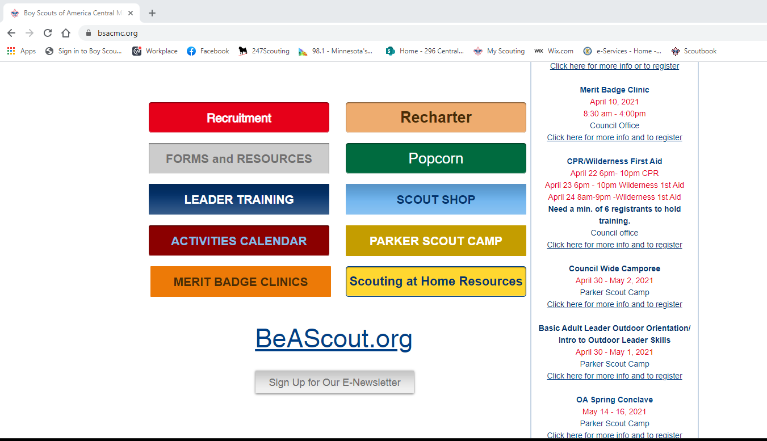
Weekly Communications from Council
To subscribe go to: bsacmc.org/subscribe
Or click the button at the bottom of our website homepage.

Slide 8
Council Updates 2021
Klondike Derby- Mar 6
Council/District Pinewood Derby March 20
Make sure you fill out form and register on website!
Merit Badge Clinic April 10
there are still openings in: Drafting, First Aid, Genealogy, Geology, Public Speaking, Traffic Safety.
Gateway District Fun Day – April 24 – Elk River
Wilderness First Aid- #2
April 22- April 24 must have minimum of 6 people to have class.
Baloo/IOLS- April 30 – May 1
Council Camporee for Scouts BSA at Parker
April 30 – May 2

Slide 9
Council Updates Continued
Parker Clean-up Day – Wilderness Engineers – May 1
Cub/Webelos Event- May 22- registration coming soon
Cub Resident Camp – Parker – Registration is open
Voyageurs – Jun 17-20
CMC Annual Golf Scramble June 28th
NYLT at Parker- June 27 – July 2, 2021
Powderhorn – July 23 - 25
Council Canoe Excursion- Aug 18 – 20, 2021
Ripley Rendezvous- Oct 8-10
Webelos Weekend at Parker – Oct 15-17
Philmont Trek – June 2022
Wood Badge – Fall 2022

Slide 10
Pinewood Derby
District/Council Wide
Virtual Pinewood Derby Race
March 20th Via Youtube
registration is on www.bsacmc.org
Cost is $5
Top 3 from each age level in each Pack or if Pack has not had Pinewood derby yet.
All participants need to register on Blackpug and fill out the google form.
Need volunteer help - track and computer, checking in cars, Producer behind the computer, Pit Crew (3 people), We need interviewers, and we need writers for the script.
Cars need to be to the council by March 12

Slide 11
Council Camporee "Wilderness Clue"
April 30 - May 2, 2021
Parker Scout Camp
$20 youth and
$5 adult and staff
Early bird ends April 13
Program features include but not limited to:
An exciting Webelos Cross Over Ceremony
Archery, 22 rifle, tomahawk throwing, Geocaching, First Aid, Knots & Lashings, campfire program, and more
Register at:
https://scoutingevent.com/296-Camporee2021

Slide 12
Buy Your Mask today
1 for $3
or
2 for $5

Slide 13
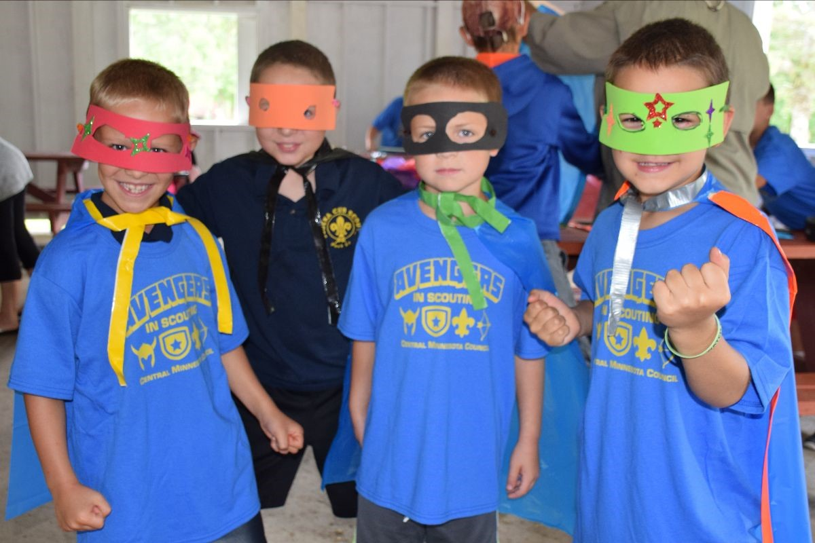
Parker Scout Camp “Super Scouts Wear a Different Mask”
Cub Scout Resident Camp
June 18-20, June 25-27, July 9-11, Weekends
July 17, Day Camp
Different programs for rank advancement
Archery, BB’s, Kayaks, Waterfront Gym
Scratch Cooked Meals!
Registration opens February 15th!
We are in need of Lifeguards: Contact Jace Carlson: 218-330-9408
Parker Scout Camp Survey - CLOSES March 15th !
Help us grow the fun at Parker Scout Camp
IN the weekly newsletter - or on Council web site
NEED ALL ADULTS to please complete it !

Slide 14
Awards
https://www.bsacmc.org/forms
District Award of Merit
Leader Awards
Council Recognition Dinner – TBD- tentatively June 2021

Slide 15
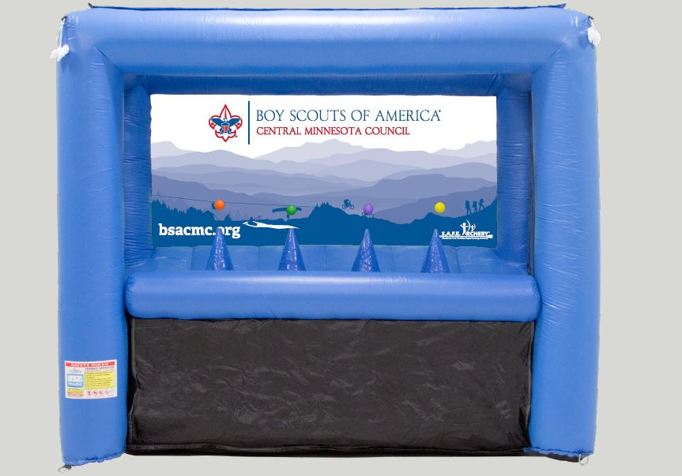
Roving Council WIDE Day Camp(s)
Theme: Weird Science
Multiple locations in each district
Check out the new Inflatable Archery Range
Contact Ken Toole:
Kenneth.Toole@scouting.org
218-780-0694

Slide 16
SCOUT SHOP UPDATES
Save 25% on select Adventure items
Feb 22 – March 13
50th Anniversary Environmental Protection Agency Award

Slide 17
Spring Sale
Beef Snack Sticks from Old World Meats – Duluth, MN.
• Caddies of 20 sticks for $20.
• Product Pick-up on March 2 – 5
Unopened Caddies can be returned
• Return Unsold Product by April 26th
• Payment Due to Scout Office by April 30th

Slide 18
Friends of Scouting
2021 Family FOS
• Schedule your unit presentation at an upcoming in person or zoom event.
•Unit Incentive for Hitting Goal
•Packs – 10% off Cub Scout Summer Camp @ Parker for Youth
•Troops – 10% off Ripley Rendezvous for Youth
•Patch for donations $100 & up
•Thank You gifts at $250 mug & $500 Daypack
•Give online at www.bsacmc.org/donate
•Leaders, pledge your support tonight!

Slide 19
Training Opportunities
BALOO/IOLS - April 30 – May 1
In conjunction with Council Camporee
Cub Scout Leader Specific Trainings
via Zoom By unit request
Youth Protection Training – using My.Scouting.org
Powder Horn -
Outdoor and High Adventure Training
at Parker Scout Camp on
July 23-25, 2021

Slide 20
Cub Scout Breakout-
Other things should, can do with Pack and Den
Scouts BSA Breakout-
Scout BSA Camps
Where do you go
How do you plan with Covid

Slide 21
Cub Scout Breakout

Slide 22
Scouts BSA Breakout

Slide 23
Questions Concerns Comments?

